Slide 1
Rock Climbing Routes.
-Nicholas Mooney

Slide 2
Idea / motivation
I climb a lot
I visit rock climbing forums a lot
Figure out what people like about routes

Slide 3
Data / attributes
Attributes explained
Instances broken down: 116,699 thousand routes
Class label: Star Rating

Slide 4

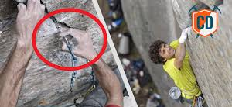
Attributes
Pitch - length
Difficulty 5.6 to 5.15
Sport – flat walls
Trad - cracks

Slide 5

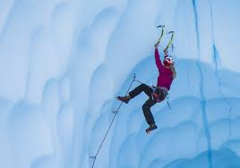
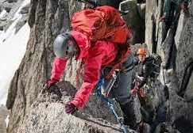
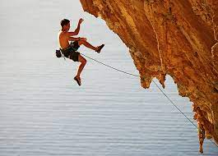
Secondary types
Aid climbing?
Ice Climbing?
Alpine Climbing?
Danger Rating

Slide 6
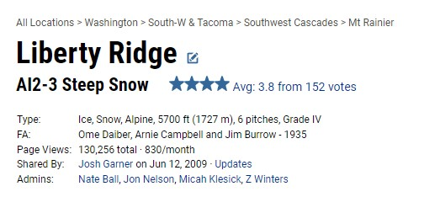
CLEANING OF DATA
Partitioning data from type?
Messy classification round to nearest star

Slide 7
EDA
Frequency diagrams
Differences between classifications would be small’
but significant
Relationship between attributes
Led to primary and secondary attributes as separated prior
Insights
It took a long time to train across the data and pick trees
A single tree was not good unless trained over the entire data
Knn was good but slow
 | single pitch |  | multipitch
 | trad-single | sport-single | trad-multi | sport-multi
5.6 | 2 | 2 | 2 | 2
5.7 | 2 | 2 | 2 | 2
5.8 | 2 | 2 | 2 | 2
5.9 | 2 | 3 | 2 | 3
5.10 | 3 | 2 | 3 | 2
5.11 | 3 | 3 | 2 | 3
5.12 | 3 | 3 | 2 | 2
5.other | 3 | 2 | 3 | 2

Slide 8
Classifiers and Results Evaluations
Dummy was terrible and always guessed 2
Accuracy of 35%
KNN (accuracy of 0.428 but very slow)
Forest (single tree 0.376 baseline on primary attributes)
(0.425 accuracy with all attributes)
N-12 M-6 forest = (0.467 accuracy with all attributes)

Slide 9

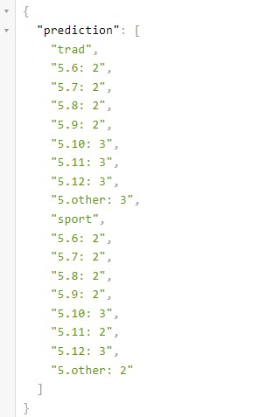
Flask demo
Unknown route considerations
Include URL:
Show response

Slide 10
FINAL FINDINGS
AID was insignificant
Alpine was better when long
Ice was better when hard
DANGER RATINGS:
Highly rated when difficult
Low rating when easy
MULTIPITCH WAS LOWER consistently except moderate alpine
Hard trad was better
Easy trad was worse
People like bolts on average

Slide 11
Improvements challenges code
Possible use for grading of locations
Weather averages
Votes for popularity : thresholds and weight
Comments and attitude of comments
Code was mostly challenging in cleaning
Making knn up to par

Slide 12
Sources / Division of labor
Project repo:
https://github.com/Nicholas-Mooney/322proj/tree/main
Sprint youtube - flask: https://www.youtube.com/watch?v=CxxAPx8e6OI&ab_channel=GinaSprint
Query params: https://stackabuse.com/get-request-query-parameters-with-flask/

